Slide 1



About Uttarayani
U T T A R A Y A N I (Regd.)
Learn, Earn & Return
Registered under Societies Registration Act, 1860
Formed in 1991
Non-political & Non-Profit making society
Members are Group A officers (origin of Uttarakhand) working or worked in Delhi NCR once in Central Govt., PSUs, Defence/ Para Military & Police forces.

Slide 2
OBJECTIVES
U T T A R A Y A N I (Regd.)
Learn, Earn & Return
Act as an interface between Government of Uttarakhand and natives for their welfare and growth
Foster and create a sense of brotherhood, cooperation, unity amongst members and people of Uttarakhand.
Provide awareness regarding developmental initiatives of Govt.
Extend all possible assistance to areas affected by natural calamities
Organize Medical health camps, Education & Training programs, Seminars & brainstorming sessions in remote areas of Uttarakhand.
Efforts for challenging task of reverse migration.
Organizing meetings, Brainstorming sessions, Motivational talks
Provide guidance to youths to secure employment.

Slide 3
Founder Members
U T T A R A Y A N I (Regd.)
Learn, Earn & Return
Late Sh. B.N. Dhondiyal Sh. P S Saklani
Sh. Manoj Pandey Sh. Mitranand Kukreti Sh. J.P. Bahukhandi Col. K N Sati
Sh. Tara Dutt Sati
Dr. P L Arya Sh. L.S. Negi Sh. C B Nailwal
Sh. J.P. Mamgain
Late Sh. Shashi Bhushan Sh. H.C. Jayal
Prof. S.P. Kala Sh. U.S. Pant Sh. T.C. Pant Sh. H.G. Upreti

Slide 4



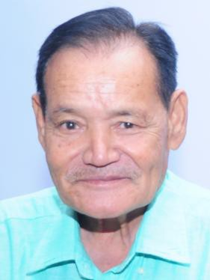
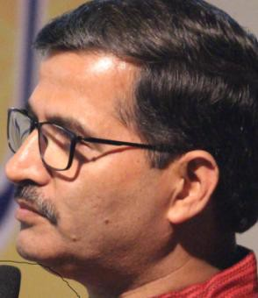
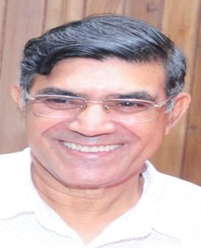

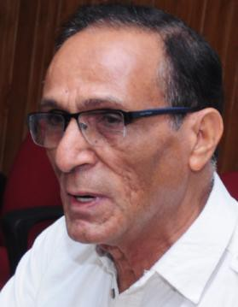
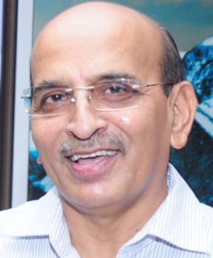
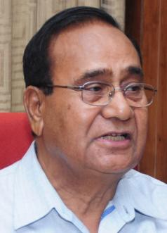
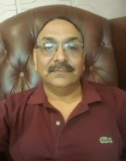
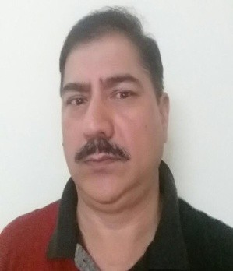
Past Presidents
U T T A R A Y A N I (Regd.)
Learn, Earn & Return
(Late) Sh. B.N. Dhondiyal
Sh. N.P. Nawani
Sh. C.M. Bahuguna
Sh. Aswani Lohani
Sh. H.C. Jayal
Col. D.P. Dimri
Sh V.N. Sharma
Sh. K. Arya
Col B. C. Pande
Sh K. N. Suyal

Slide 5
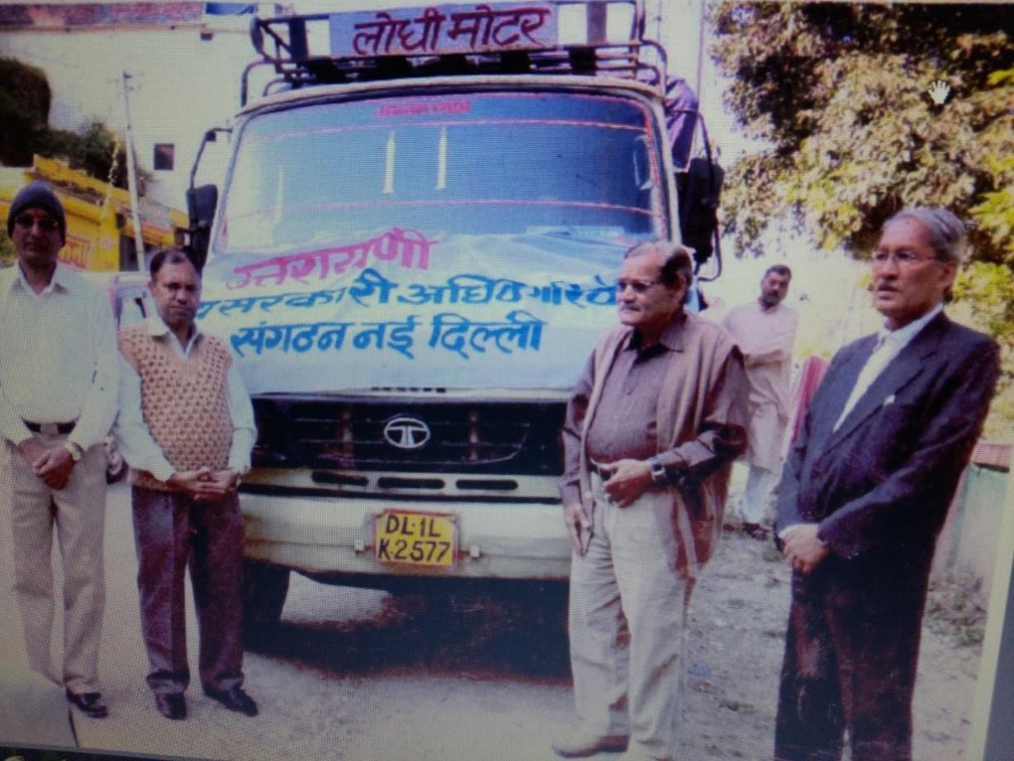
Prominent activities
U T T A R A Y A N I (Regd.)
Learn, Earn & Return
Provided Food, Clothing and Household items to affected people of
Uttarkashi (1991)
Ookhimath (1996)
Haridwar (2011)
Ookhimath (2012)
Kedar Valley (2013)

Slide 6
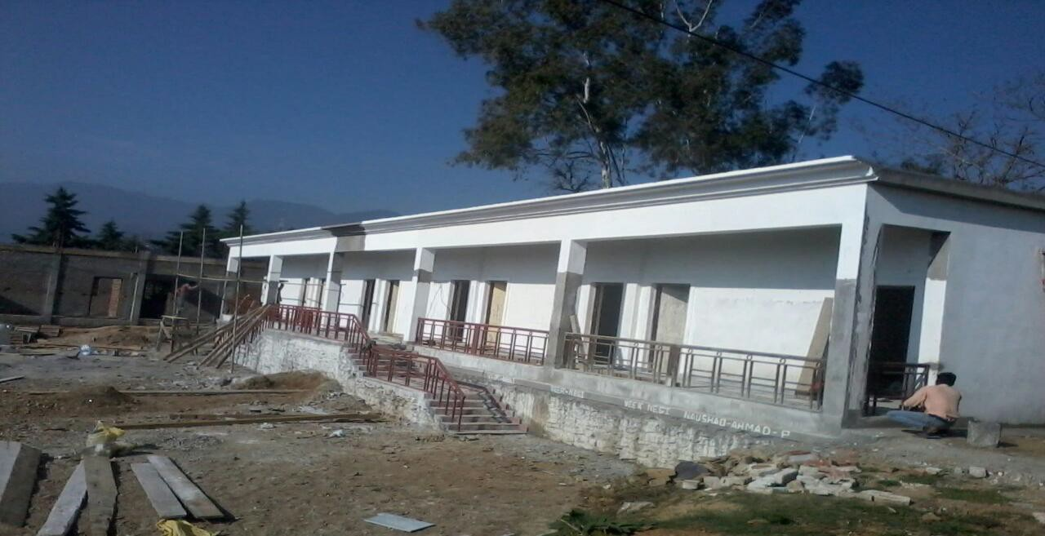
Prominent activities contd…
U T T A R A Y A N I (Regd.)
Learn, Earn & Return
Construction of 5 rooms and 4 toilets in School Building at Govt. Inter College Naini,Karna-Prayag, Chamoli with the help of Mahavir International (NGO)

Slide 7
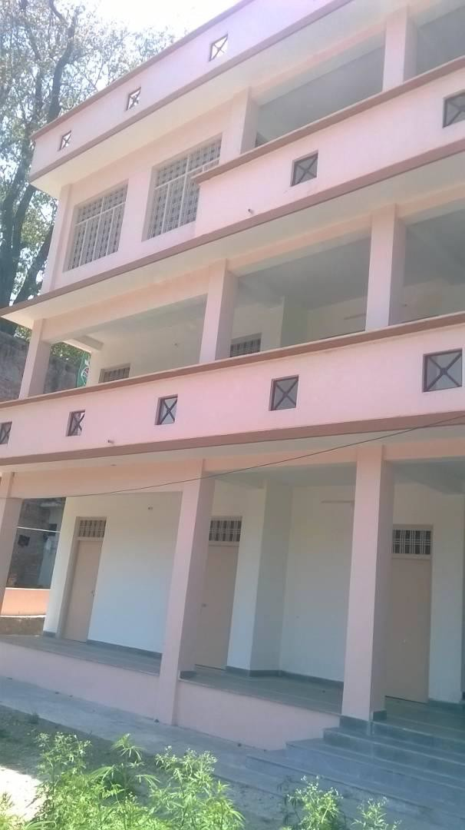
Prominent activities contd…
U T T A R A Y A N I (Regd.)
Learn, Earn & Return
Initiated for arranging funds from Indian Oil Corp.Ltd (IOCL) through Late Sh. R.S. Butola (Member Uttarayani & then CMD IOCL) for construction of
“ Centre of Excellence” at Rudra-Prayag.
Building was built under supervision of Uttarayani, in memory of 283 children died during Kedarnath tragedy (2013)
COE will act as Information cum coaching centre for various training and skill development for youth of Uttarakhand.
MoU with DM Administration Rudraprayag signed on 7th December 2019, for operationalising CoE.
Meeting of Integrated management committee of CoE held on 11th Feb 2020.
Selection of Faculty for CoE to be scheduled
shortly(Postponed due to COVID19)

Slide 8
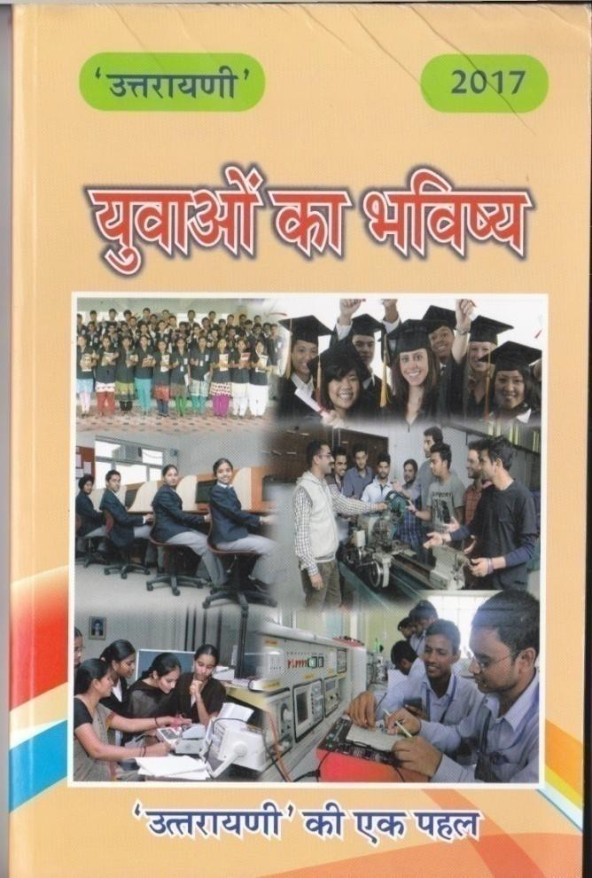
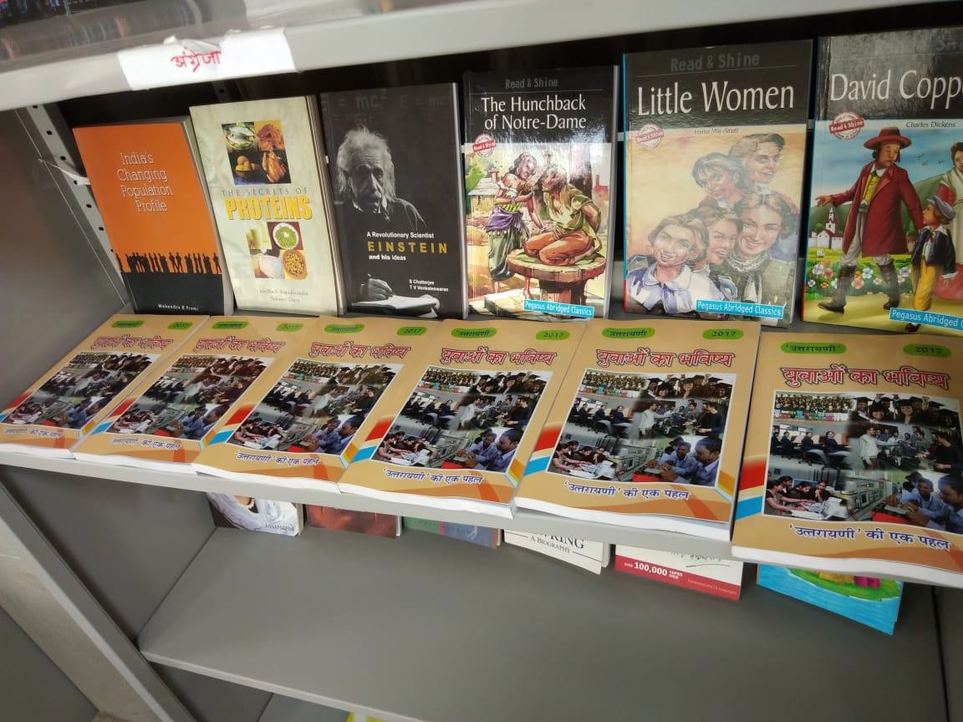
Prominent activities contd...
U T T A R A Y A N I (Regd.)
Learn, Earn & Return
Publication of Book for youth, containing necessary information for choosing a suitable career in different streams
Free distribution of more than 15000 books during 100 seminars conducted across the remote areas of Uttarakhand in last 3 years

Slide 9
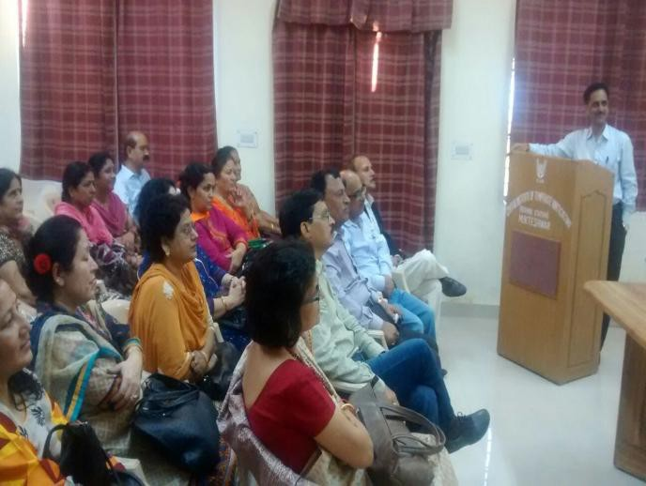
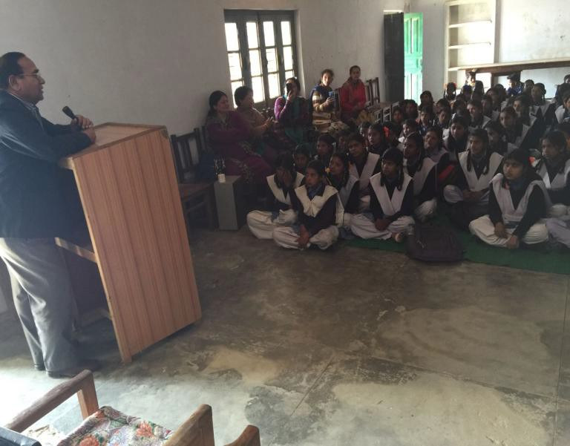
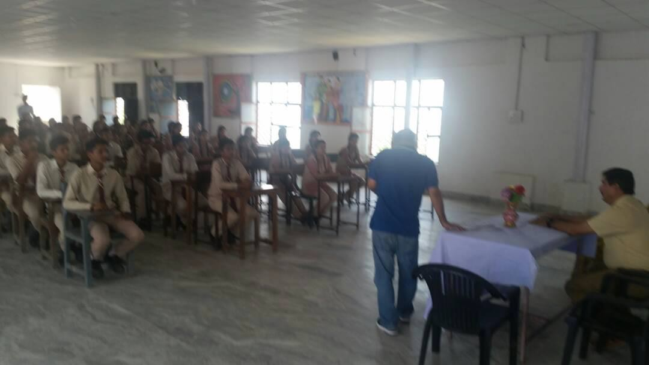
Prominent activities contd…
U T T A R A Y A N I (Regd.)
Learn, Earn & Return
To conduct Seminars in remote schools and colleges to create awareness & information to get jobs in Central & State govt. and PSUs, Banking Sector, Armed Forces and other departments.
To instill courage and confidence in our youths for seeking jobs

Slide 10
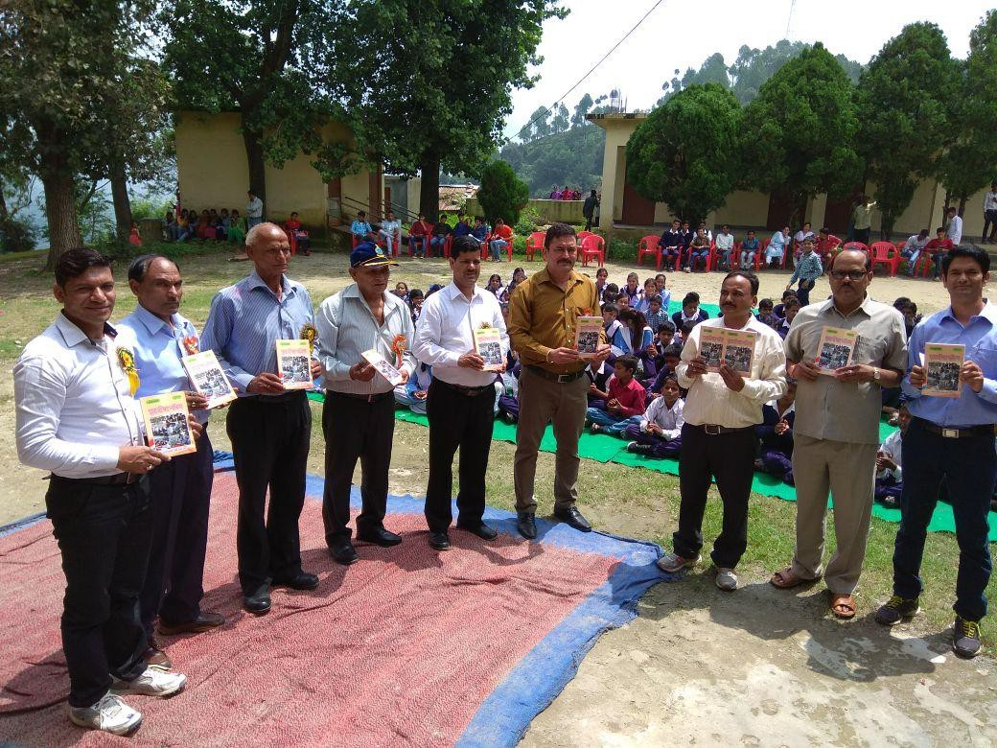
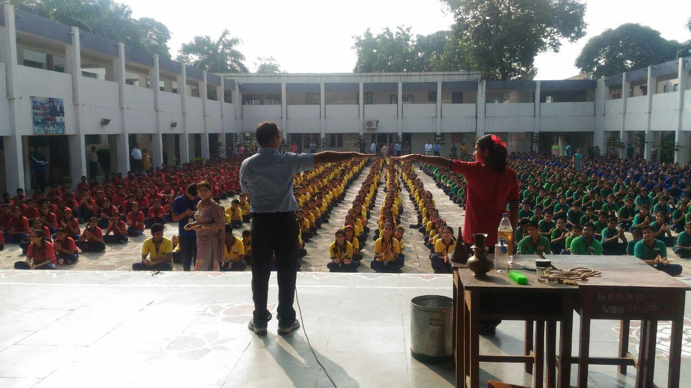
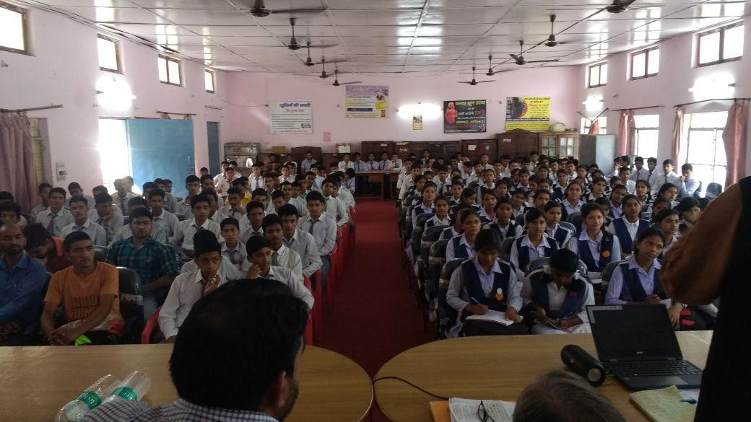
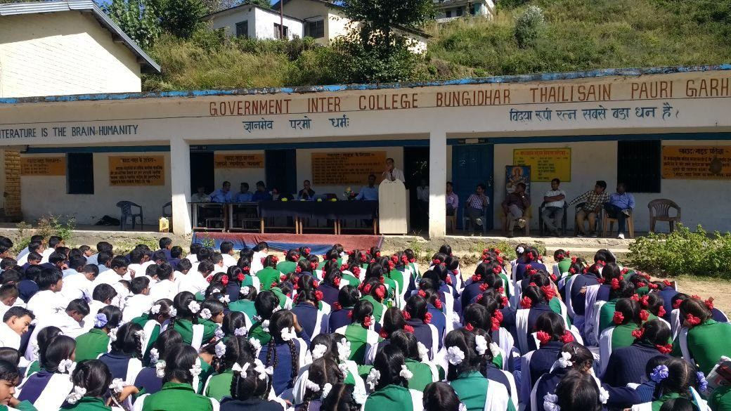
Prominent activities contd...
U T T A R A Y A N I (Regd.)
Learn, Earn & Return

Slide 11



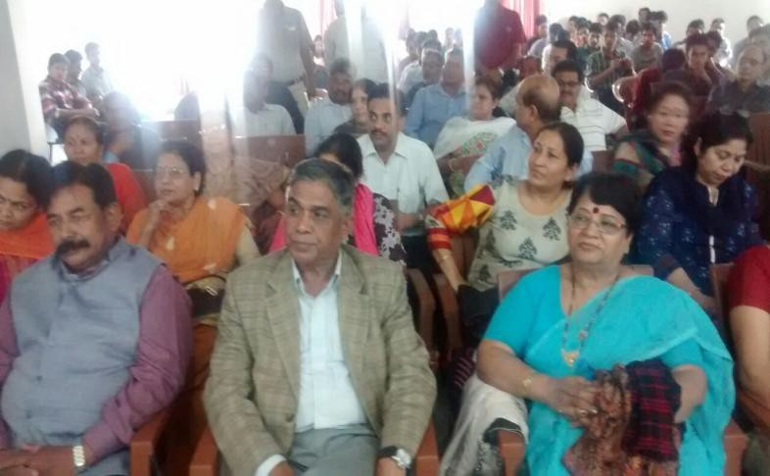
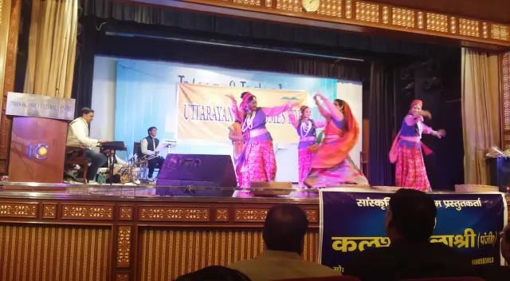
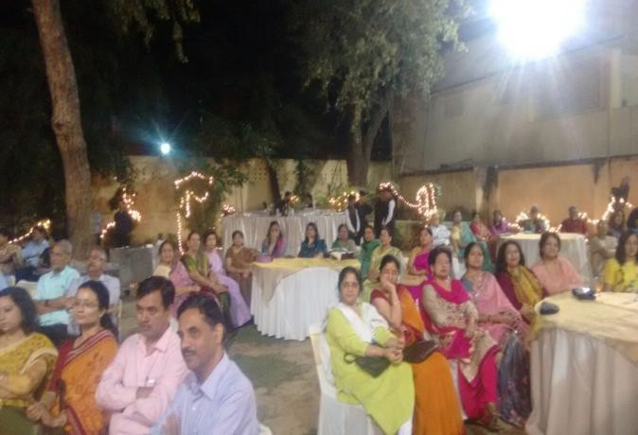
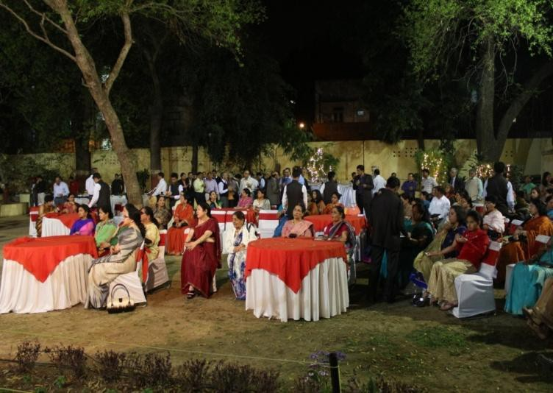
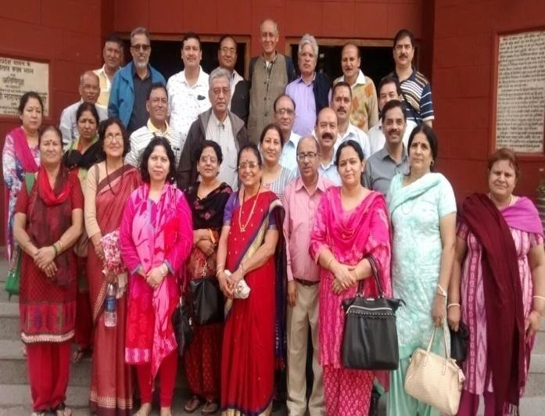
Prominent activities contd…
U T T A R A Y A N I (Regd.)
Learn, Earn & Return
Organize time to time get-togethers to strengthen our social network and sharing of ideas amongst members for overall development of Uttarayani and Uttarakhand

Slide 12
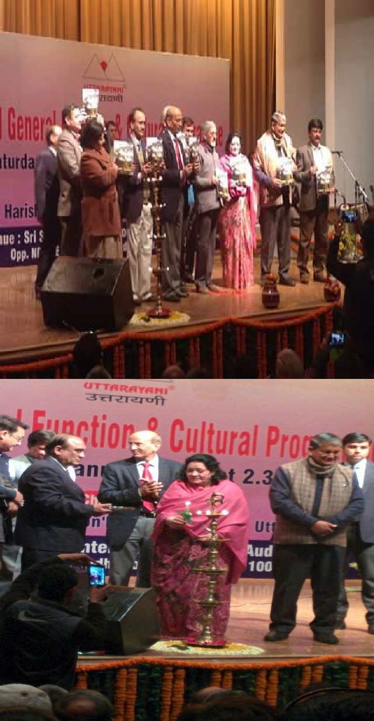
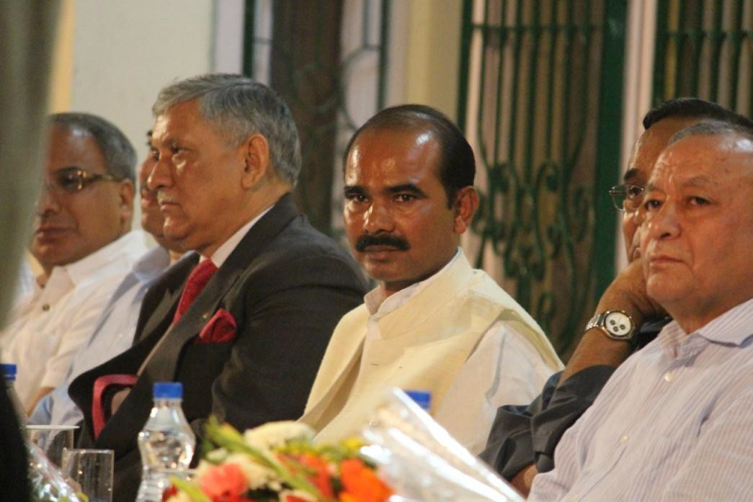
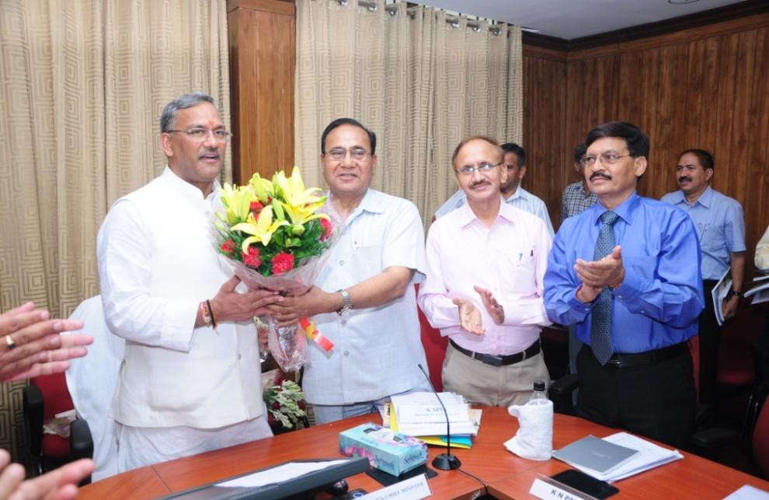
VVIPs at Uttarayani functions
U T T A R A Y A N I (Regd.)
Learn, Earn & Return

Slide 13
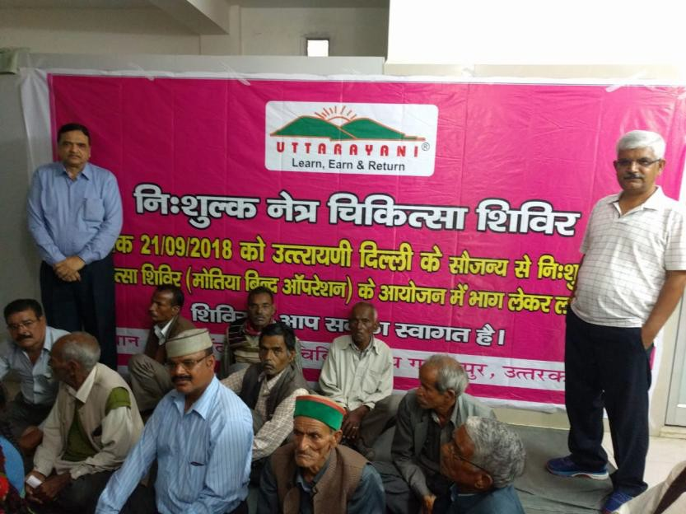
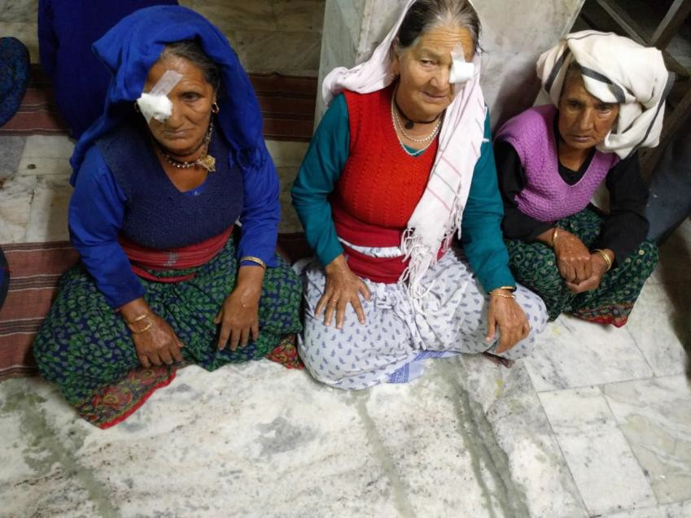
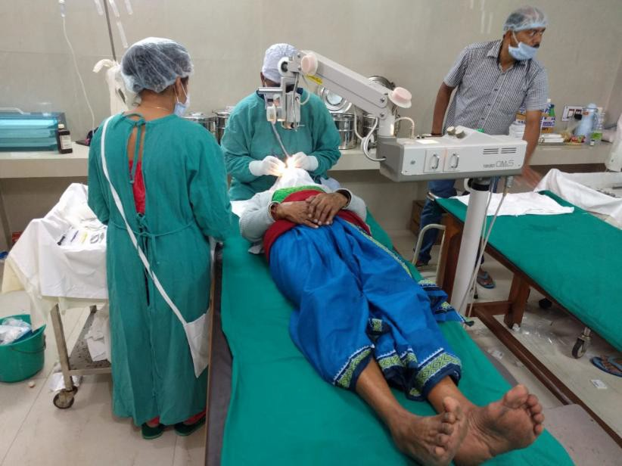
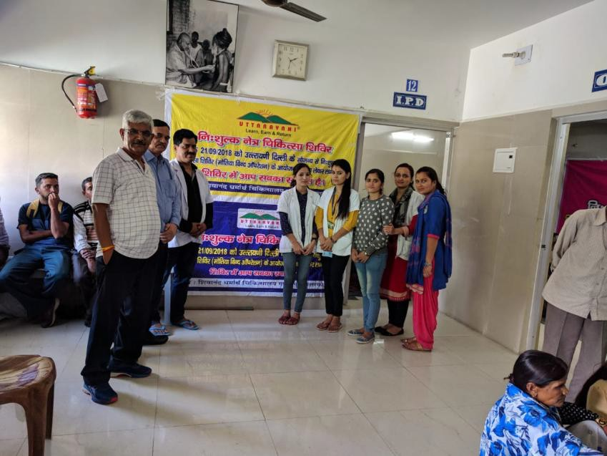
Eye Camp (2018)

Slide 14
ACTIVITIES since May 2019
Followup with RoS
E-Filing of form 10G
14 Subgroups on WhatsApp for better connectivity
with one EC member as Group admin. All efforts made to trace members not available on social media.
MoM of all EC meetings circulated to all members &
also uploaded on Uttarayani website.
Renewal of Uttarayani Domain and Hosting space for 10 years
New members joined 150

Slide 15
ACTIVITIES since May 2019 contd..
Wheelchair cricket team of uttarakhand felicitated
Delegation met with the MPs and handed over a report on projects that need to be undertaken in Uttarakhand
Delegation met with CMD, Air India for improvement of air services in uttarakhand.
Two members visited dehradun to attend a seminar organised by groups working on the ground in order
to have a better understanding of ground situation and
forge tie up with them for integrated effort

Slide 16
ACTIVITIES since May 2019 contd..
Seminar on water conservation in the state of Uttarakhand Followed by Pilot project for rejuvenation of two springs are underway. (Proposal submitted to ONGC for CSR funds)
Forged a collaborative tie-up with UDRF for Conducting the water conservation seminar and post Seminar activities.
Visited Dehradun again to meet DG, UCOST
Ammnended Uttarayani MoA and Rules & Regulations in SGBM on 31st Aug.’19 and ratified on 2nd Nov.’19 Submitted to RoS.

Slide 17
ACTIVITIES since May 2019 contd..
Exemption under 80G under IT Act 1961 granted to UTTARAYANI on 28th February 2020. (ITBA/EXM/S/80G/2019-20/1025863402(1))
Donation of Rs 200000/= to CM relief fund to fight
against COVID19 pandemic approved by EC.
Members contributed wholeheartedly to PM CARES FUND and also contributed by distribution of daily needs, medical aid (masks, sanitizers), food packets
etc. to migrant Uttarkhandi residents across India.

Slide 18
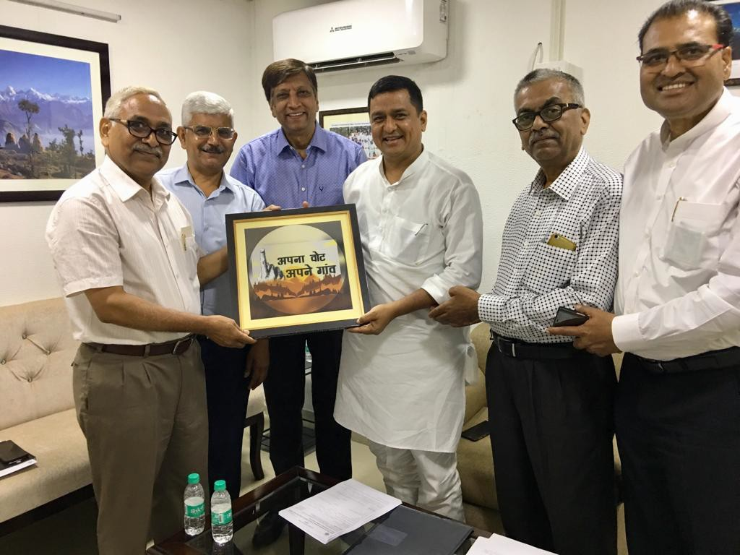
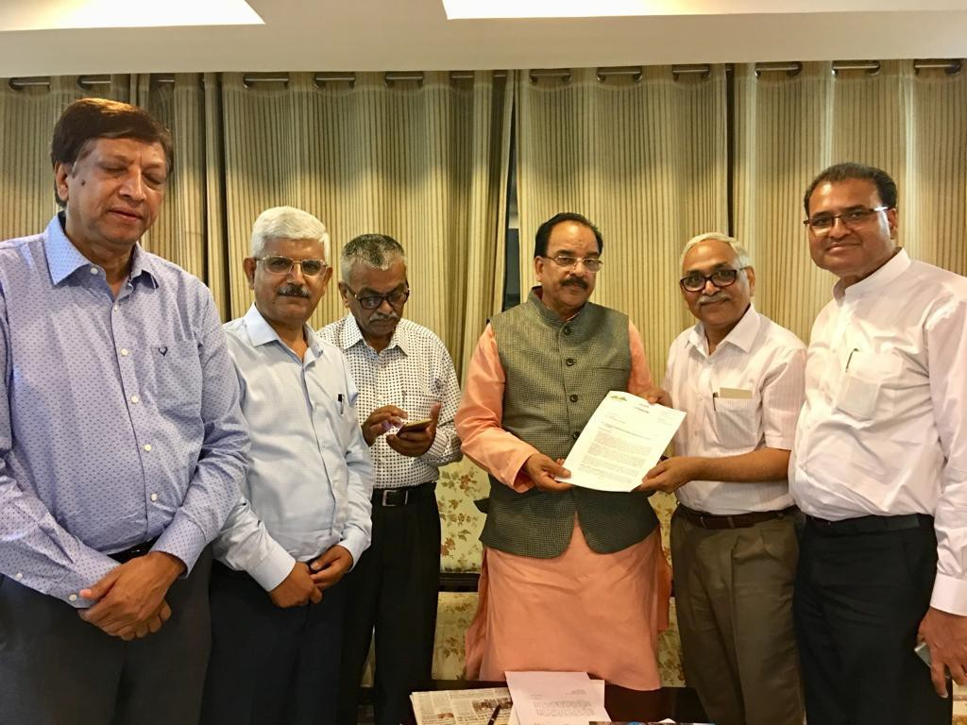
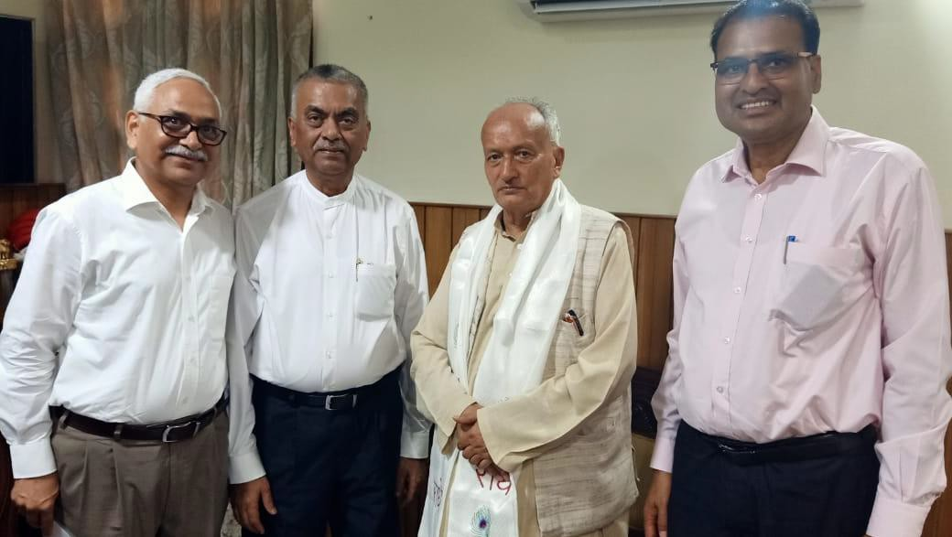
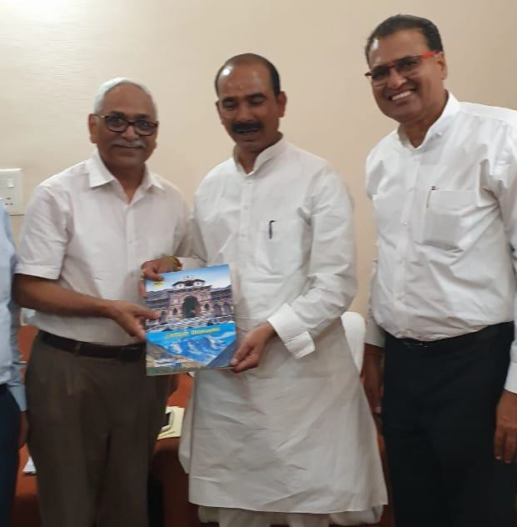
UTTARAYANI May 2019 Onwards

Slide 19
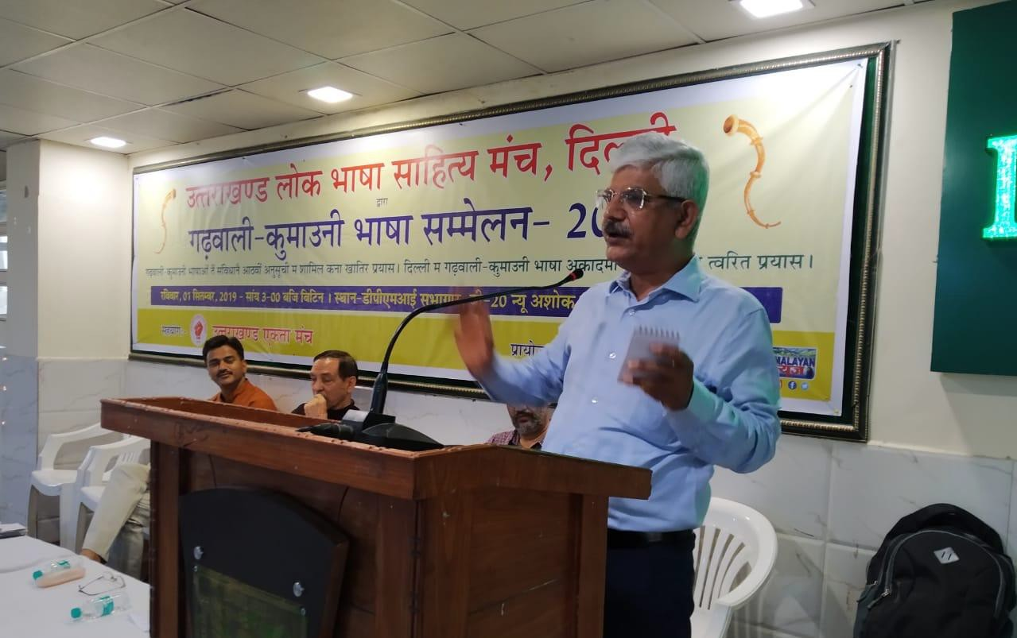
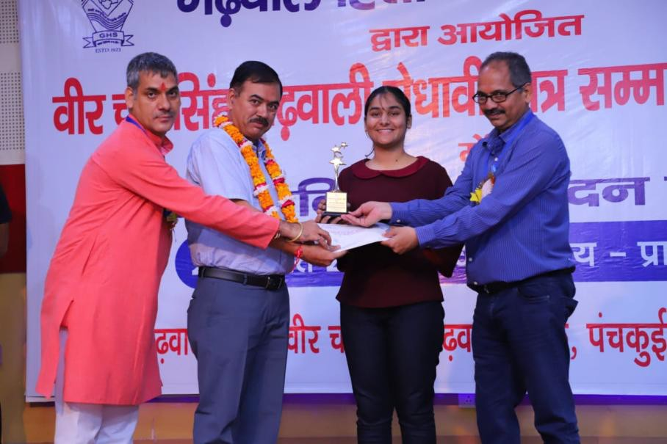
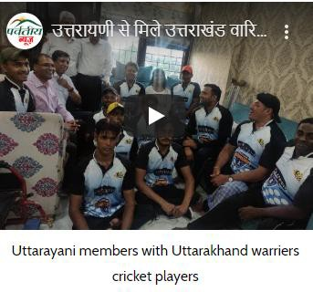
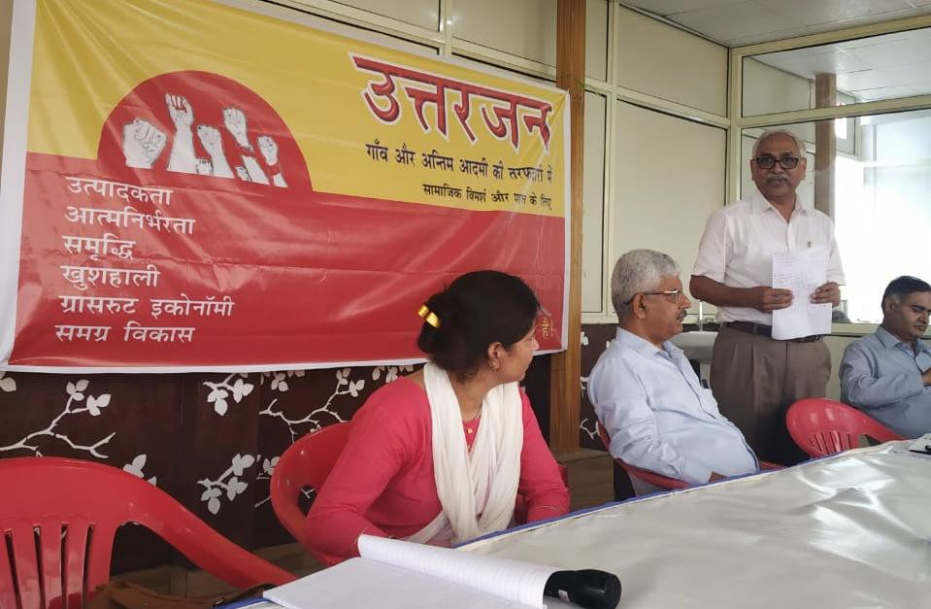
UTTARAYANI May 2019 Onwards

Slide 20
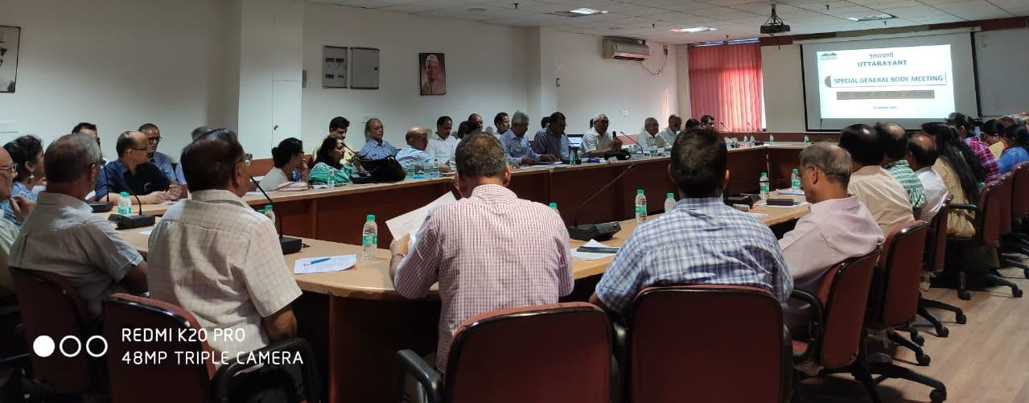
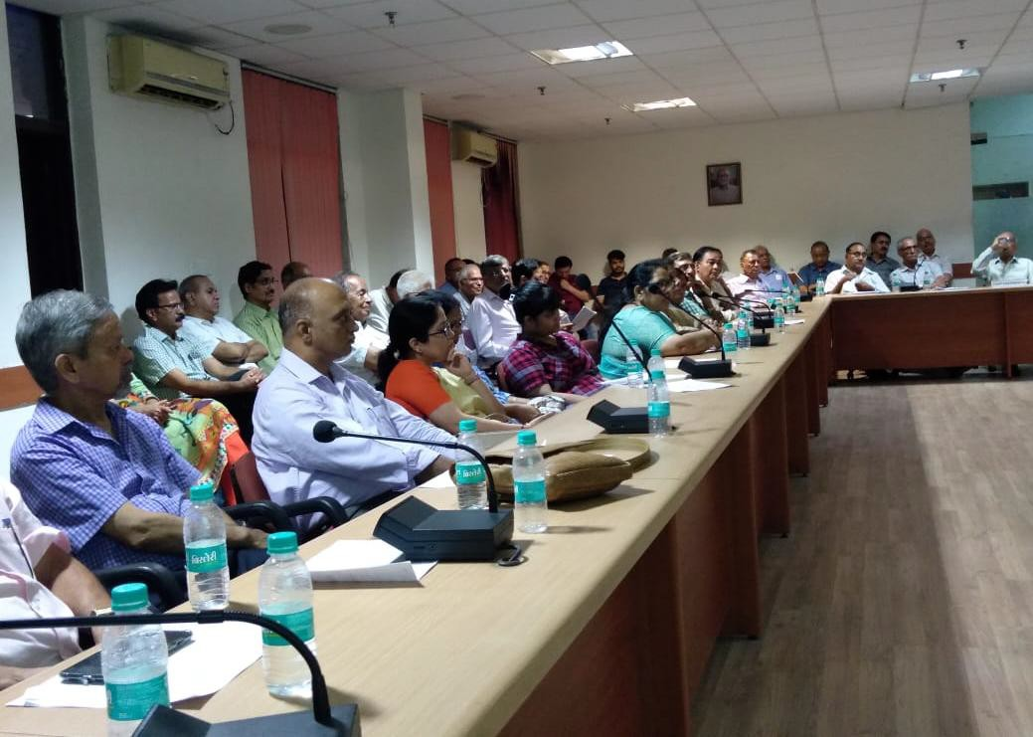
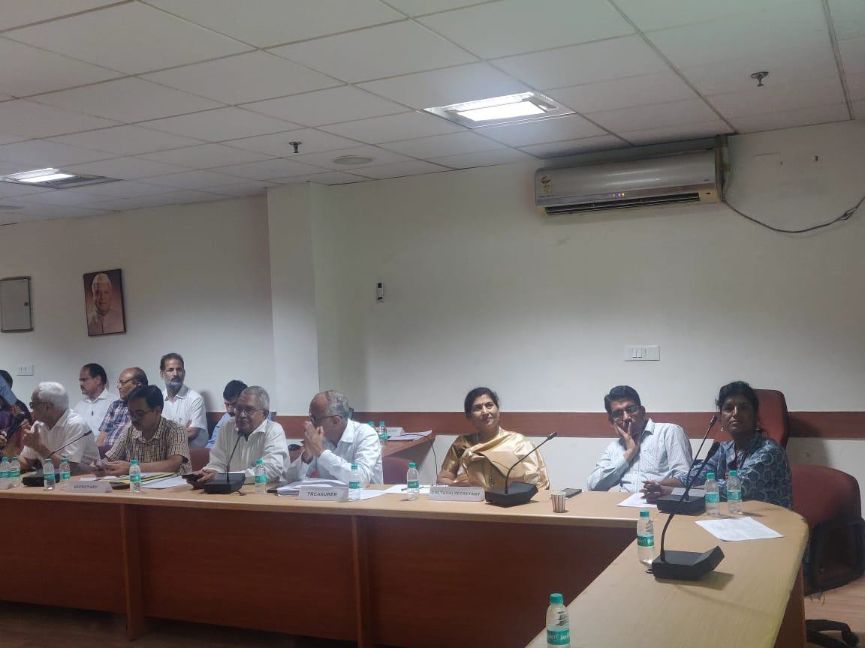
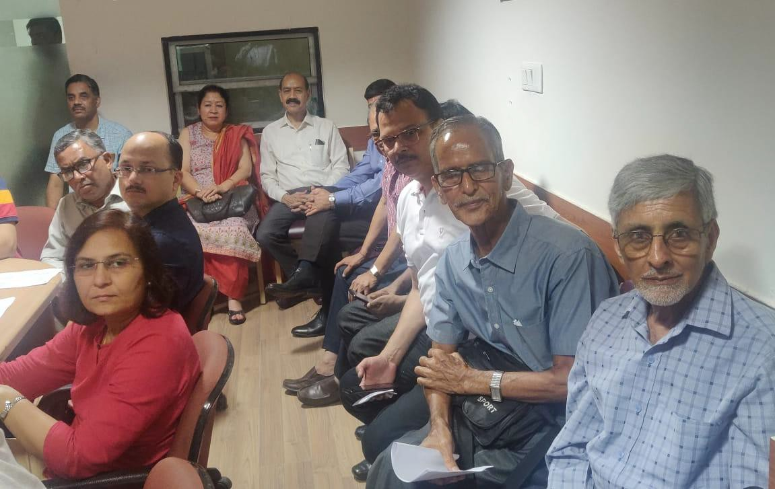
Special General Body Meeting 31st Aug. & 2nd Nov.19

Slide 21

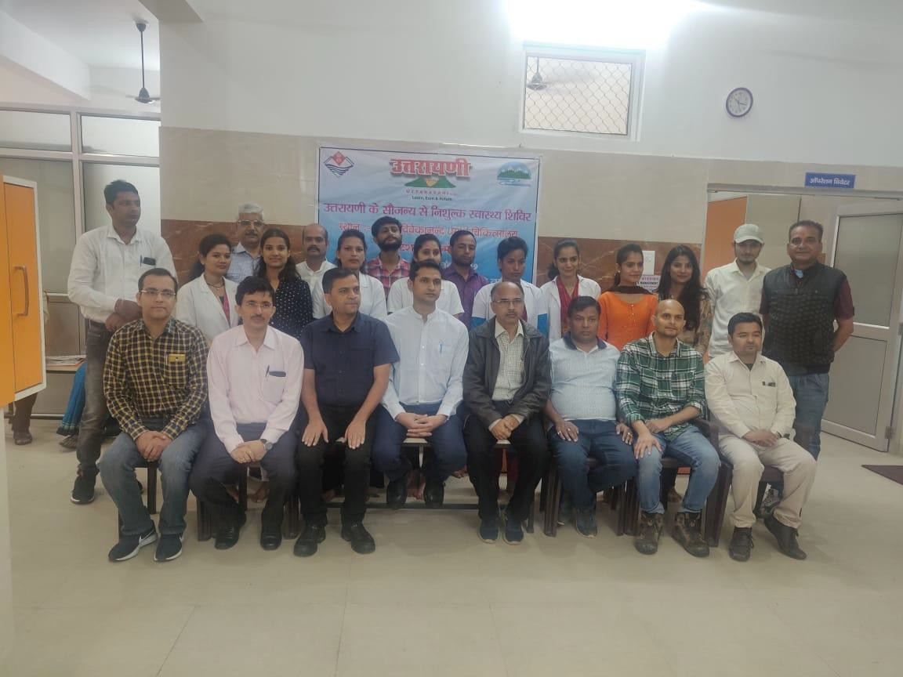
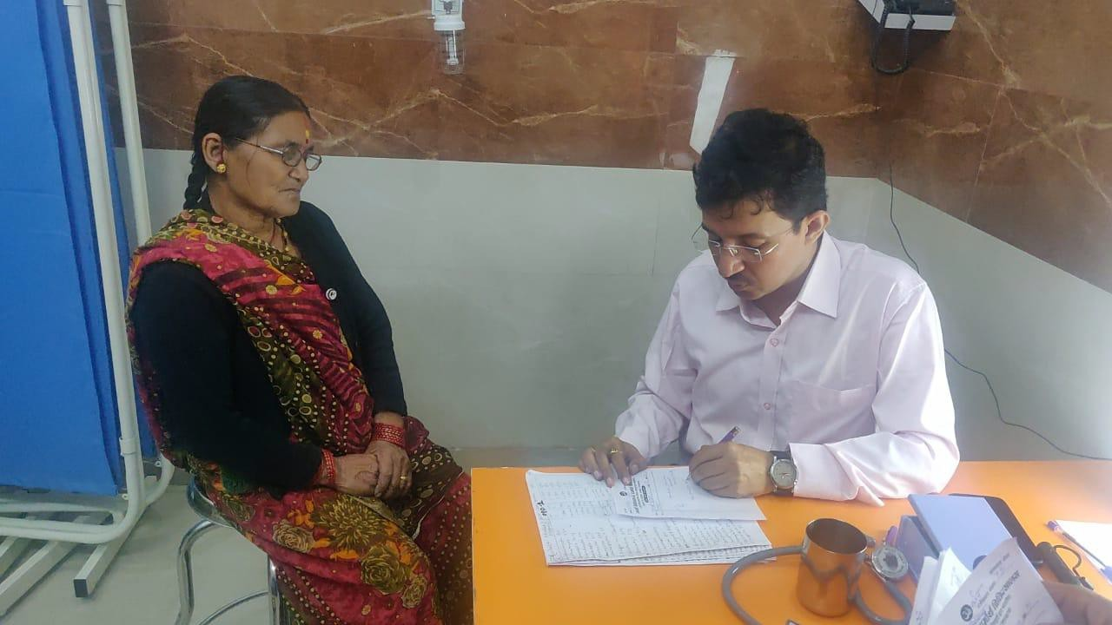
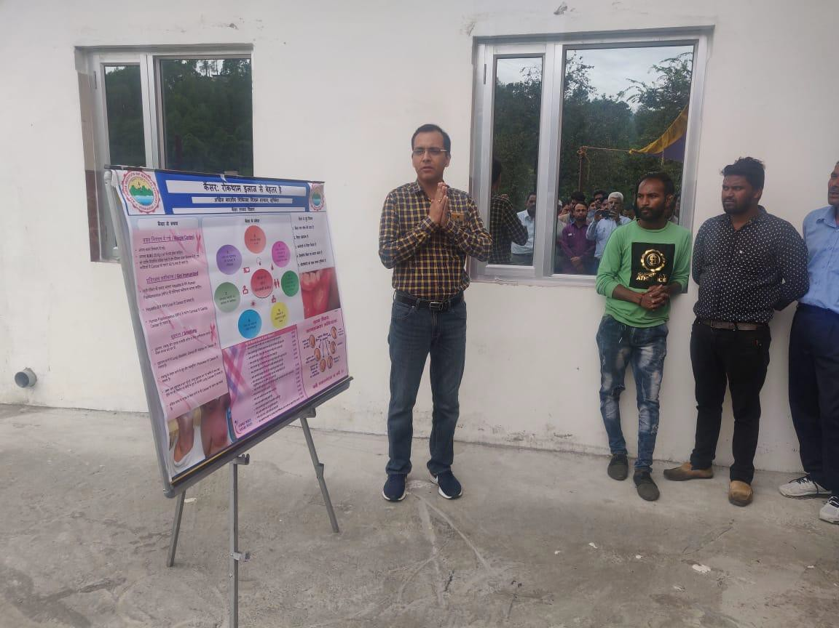
Medical Camp 22nd September, 2019

Slide 22
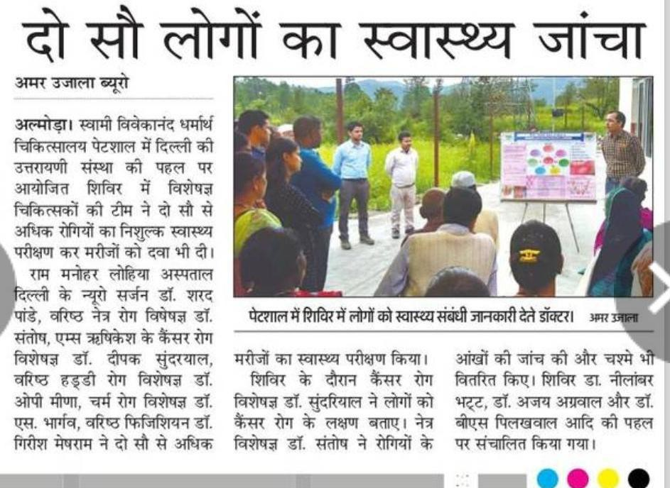

Slide 23
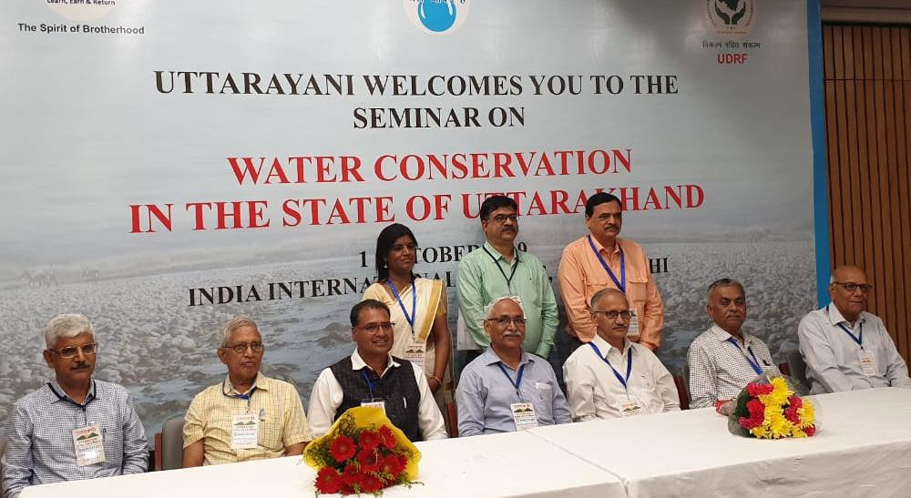
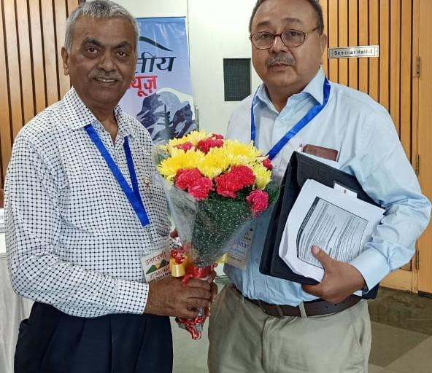


Water Conservation Seminar 1st October 2019

Slide 24


Slide 25


Slide 26


www.uttarayani.in
UTTARAYANI WEBSITE

Slide 27


Slide 28



Cultural Program 23rd November 2019

Slide 29




Cultural Program 23rd November 2019

Slide 30




Cultural Program 23rd November 2019

